Slide 1

Smart Expense & Financial Insight System
“SmartExpense” - A web app to track expenses, monitor budgets & forecast future spending
Submitted By:
Muskan Rajpal
KID: K25162 | BCA-V Sem.
School of Computer Applications,
Career Point University, Kota
Under Supervision:
Mr. Parveen Kr. Goyal
School of Computer Application & Technology,
Career Point University, Kota
www.cpur.in

Slide 2
Index
01. Introduction & Problem Statement
02. Objectives
03. Proposed Product
04. How It Works
05. Key Features
06. Tools & Technologies
07. Expected Outcomes
08. Future Scope
www.cpur.in

Slide 3
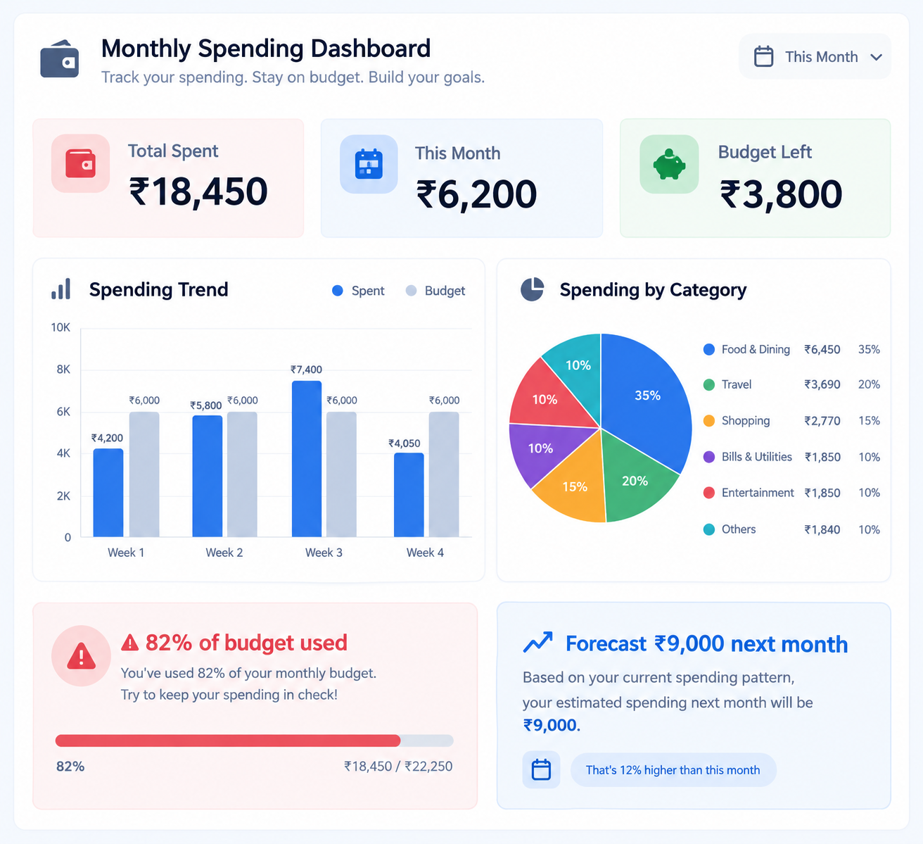
Introduction & Problem Statement
Introduction
Smart Expense & Financial Insight System is a web-based personal finance manager that helps users record, categorize and monitor their daily expenses in one place. It tracks spending against a monthly budget, visualizes patterns through interactive charts, and estimates the next month's spending from past data, all without any bank or payment-gateway integration.
Problem Statement
Most people track expenses casually - in notebooks, memory, or scattered notes, with no simple way to see where money is actually going. This makes it easy to overspend without noticing, hard to compare spending across months, and nearly impossible to plan ahead, leading to poor financial visibility and budget overruns.
www.cpur.in

Slide 4
Objectives
Centralized expense tracking: Let users record every expense in one place with category, date and payment mode, replacing notebooks and scattered notes.
Real-time budget monitoring: Continuously calculate spending against the monthly budget and surface the remaining balance instantly.
Visual financial insight: Turn raw expense data into category-wise and month-wise charts that are easy to read at a glance.
Proactive budget alerts: Automatically warn the user once spending crosses safe, warning, critical and over-budget thresholds.
Simple, reliable forecasting: Estimate next month's spending from the historical average, with no dependency on bank data or heavy ML.
www.cpur.in

Slide 5
Proposed Product
What it is: A web application ("SmartExpense") built with Flask and SQLite, where users log in, record expenses with a category and payment mode, set a monthly budget, and view everything on a single dashboard.
What it does:
Lets users add, edit, delete and view expenses tagged by category, date and payment mode.
Calculates running totals - total spent, monthly spend, remaining budget - automatically.
Renders category-wise and month-wise spending charts using Chart.js.
Flags budget status with alerts once usage crosses 70%, 90% and 100% thresholds.
Forecasts next month's spending from the average of previous months' spending.
Key idea: The database is the single source of truth - every dashboard number, chart and alert is calculated live from stored expense records, never estimated on the frontend.
www.cpur.in

Slide 6
How It Works
Register / Login
User creates an account or signs in to their dashboard
Add Expense
Enters amount, category, description, date & payment mode
Categorize
Expense is tagged (Food, Travel, Bills…) for analysis
Save & Store
Flask validates input; SQLAlchemy saves it to SQLite
Dashboard Updates
Totals, charts & recent transactions refresh instantly
Budget Check
System compares spend to budget and raises alerts
www.cpur.in

Slide 7
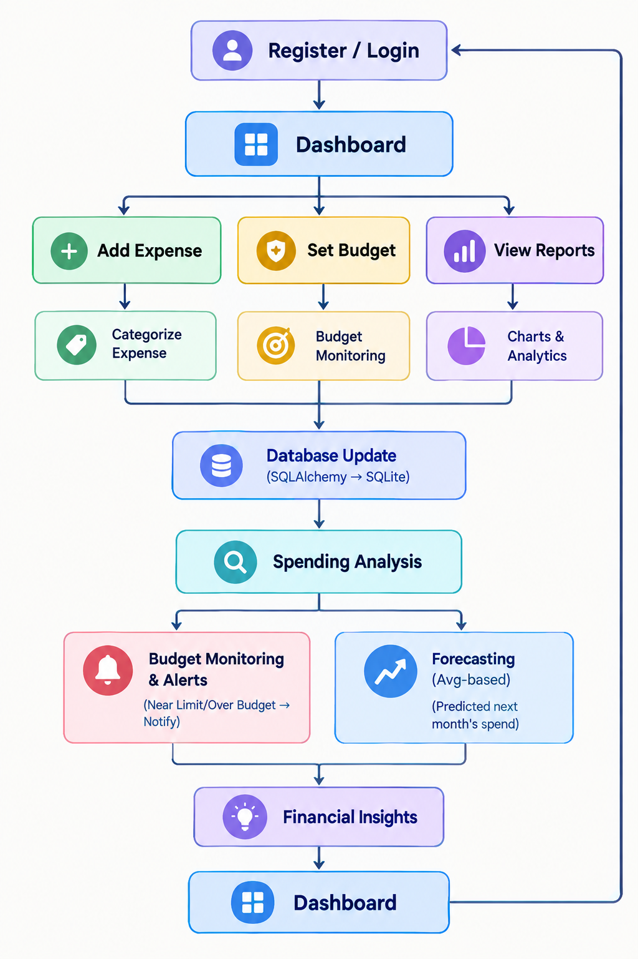
COMPLETE SYSTEM WORKFLOW
www.cpur.in

Slide 8
Key Features
Expense Tracking - Add, edit, delete and view expenses with amount, category, date & payment mode.
Smart Categorization - Tag every expense into Food, Travel, Bills, Shopping & more for clear analysis.
Interactive Dashboard - See total spent, monthly spend and remaining budget at a glance.
Visual Analytics - Category-wise and month-wise spending charts powered by Chart.js.
Budget Alerts - Automatic Normal / Warning / Critical / Over-Budget alerts as spending grows.
Expense Forecasting - Predicts next month's spend from the average of previous months.
Payment Mode Analysis (full-width) - Breaks down spending by Cash, UPI, Debit/Credit Card and Net Banking to show how you pay, not just what you spend on.
www.cpur.in

Slide 9
Tools & Technologies
Tools | Description
HTML5 | Structures every page
CSS + Bootstrap 5 | Responsive styling
JavaScript | Form checks, dynamic UI
Chart.js | Spending charts
Python - Flask | Backend framework, routes requests
SQLAlchemy | ORM mapping objects to tables
SQLite | Stores users, expenses, budgets, forecasts
Git & GitHub | Version control
www.cpur.in

Slide 10
Expected Outcomes
Expected Outcomes
Faster, centralized expense tracking with no more scattered notes.
Real-time visibility into remaining budget and spending pace.
Clear category-wise and month-wise insight through charts.
Fewer surprise overspends thanks to automatic budget alerts.
A working, demonstrable full-stack project for evaluation.
www.cpur.in

Slide 11
Future Scope
Future Scope
Linear Regression-based forecasting for more accurate predictions.
Automatic, description-based expense categorization (e.g. "Uber" → Travel).
Multi-user support with shared or family budgets.
Bank / UPI statement import for automatic expense entry.
A companion mobile app once the web version is stable.
www.cpur.in

Slide 12

www.cpur.in

